Slide 1
DAY-4 DYNAMIC FRONTENED COMPONENTS REPORT
Product Listing: Displays products dynamically with essential details.
Product Detail Page: Showcases detailed information for individual products.
Add to Cart: Enables users to add items to their cart with ease.
Wishlist: Allows users to save and manage their favorite products.
Search Bar: Provides instant product search functionality.

Slide 2
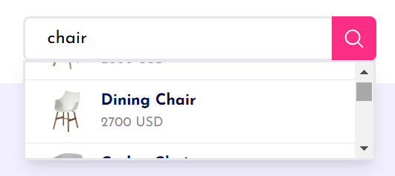
1.SEARCH BAR FUNCTIONALITY :
A dynamic search bar provides instant product search functionality, allowing users to find relevant products quickly. With auto-suggestions and product previews, it enhances navigation and improves the overall shopping experience.

Slide 3
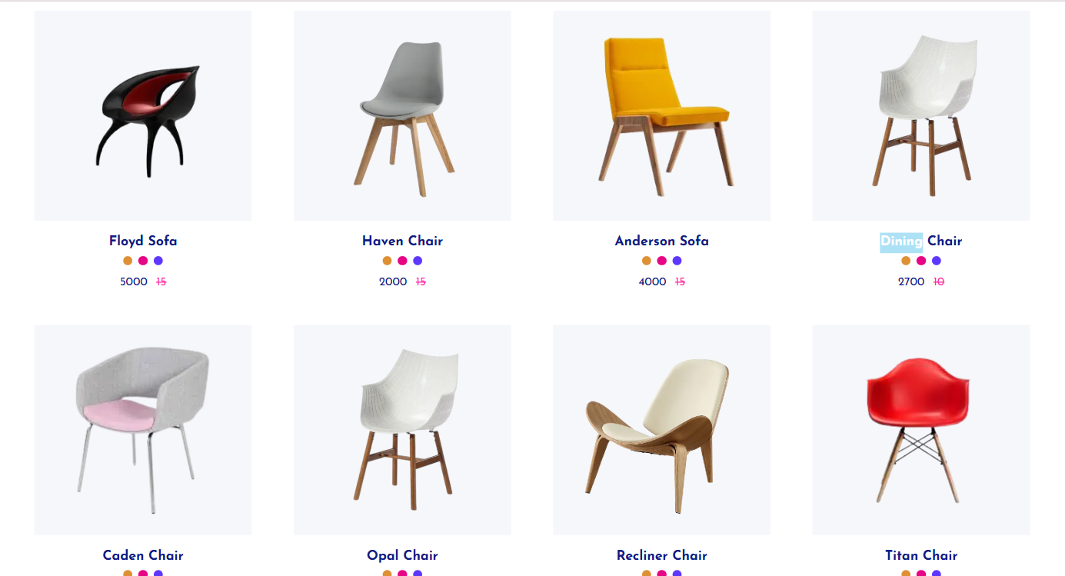
2. DYNAMIC PRODUCT LISTING :
The product listing page dynamically displays all available products, providing users with essential details such as product name, price, and image. It ensures an organized and visually appealing layout, making browsing easier. Sorting and filtering options can be integrated for better usability.

Slide 4
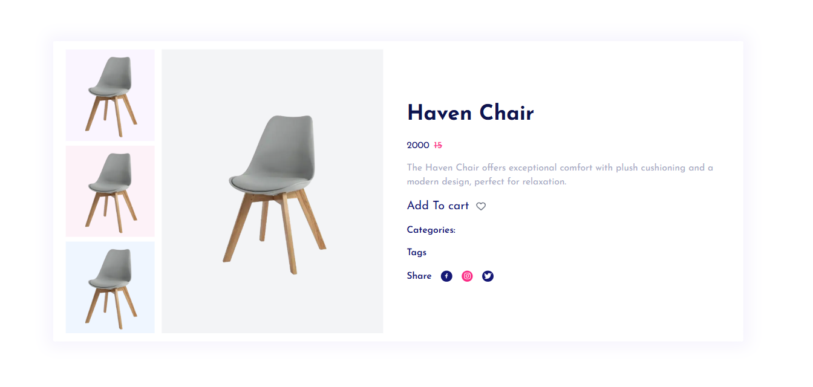
3. PRODUCT DETAIL PAGE :
This page provides in-depth information about a selected product, including its description, price, specifications, and high-quality images. Users can view detailed insights before making a purchase decision, improving engagement and conversion rates.

Slide 5
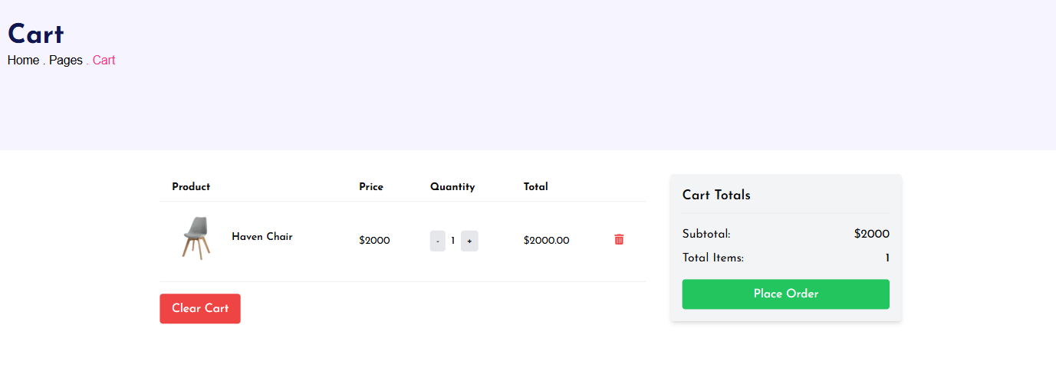
4. ADD TO CART FUNCTIONALITY :
The add-to-cart functionality allows users to select products and store them in their cart for later checkout. It enhances the shopping experience by enabling quantity adjustments, item removal, and real-time cart updates, ensuring a seamless purchasing process.

Slide 6
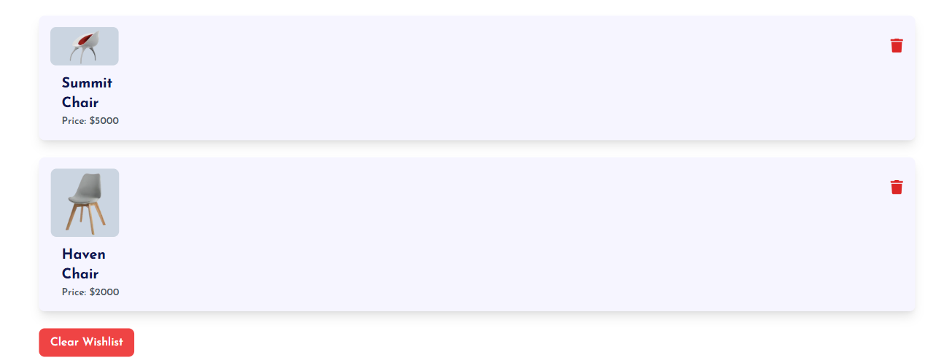
5. Wishlist FUNCTIONALITY :
The wishlist feature lets users save their favorite products for future reference. It improves user retention by allowing them to revisit and purchase saved items later. This functionality is particularly useful for customers who are not ready to buy immediately but want to keep track of desired products.

Slide 7
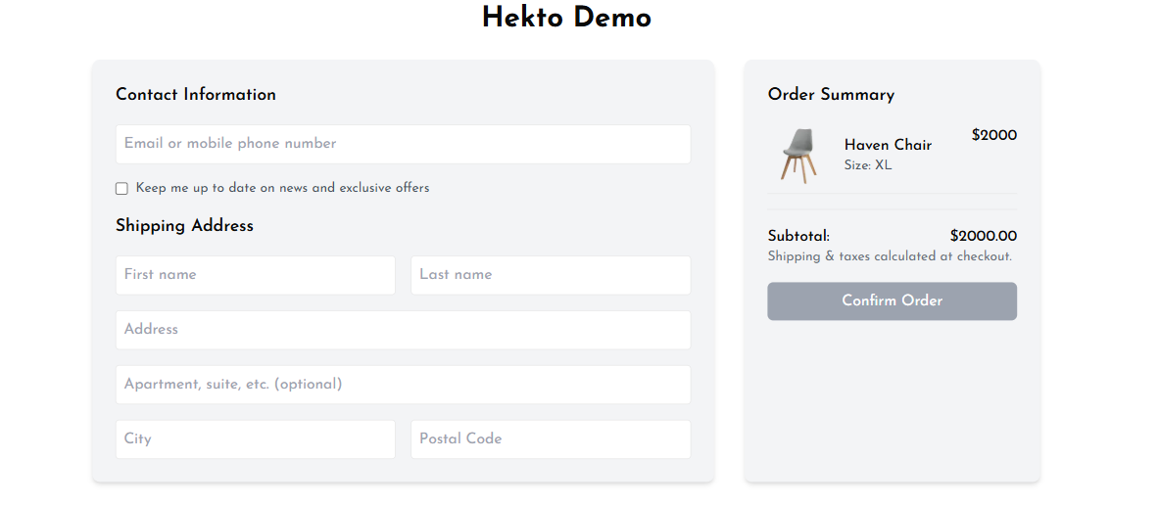
6. BILLING PAGE :
The billing page is designed to be user-friendly and responsive, providing a smooth checkout experience. It includes essential details like order summary, payment methods, shipping information, and invoice generation, ensuring a hassle-free transaction process.

